Slide 1
Criminal Sketch Net
Text-to-image Synthesis Using
a Generative Adversarial Network
Alex Richards
Mina Yi

Slide 2
Project Overview
What
Use a generative adversarial network (GAN) to synthesize images from text
Trained using images of faces and text descriptions of these faces
Why
Being able to generate/manipulate images from text has many applications:
photo editing
style transfer
character modeling
criminal suspect sketch rendering
natural extension of speech-to-text systems

Slide 3


Background - GANs
Developed in 2014 by Ian Goodfellow et al.
Novel training scheme which pits a discriminator (D) against a generator (G)
D and G play a zero-sum game which creates the following minmax value function:
D(x) is the probability that D correctly identifies a real image as real, i.e.
D(G(z)) is the probability that D incorrectly identifies a generated image as real
If a Nash equilibrium is attainable, then the network stabilizes once i.e. ; the discriminator cannot distinguish between real and generated data and the generator has learned the distribution of observed data
[1]

Slide 4
Background - Conditional GANs
Mirza and Osindero, in 2014, modified the GAN architecture by conditioning G and D on some additional data Y:
Allows for controlled modality of generated data
Vanilla GAN learns (generally) a unimodal Gaussian distribution of observed data
Conditional GAN can learn multimodal distributions (similar to a mixture model) by associating class labels, etc. with observations
Can condition on many things:
Images-images: transfer style of conditioning image to generated images
Images-text: generate captions for images
Text-images: generate images from text
[2]

Slide 5
Text-to-Image Synthesis: State-of-the-Art
StackGAN was introduced in 2016 by Zhang et al.
Uses standard conditional GAN for stage I to generate 64x64 images
Uses a second G and D pair in stage II to upsample 64x64 images to 256x256
Reconditions generated distribution using residual learning (He 2015)
Motivated by the idea that one-pass upsampling to high-dimensional space is ineffective because generated distribution and observed distribution are very unlikely to overlap in higher dimensions
Leverages overlapping G and observed distributions of stage I model to improve the stage II generator’s ability to find a G distribution that overlaps the observed data
[3]

Slide 6
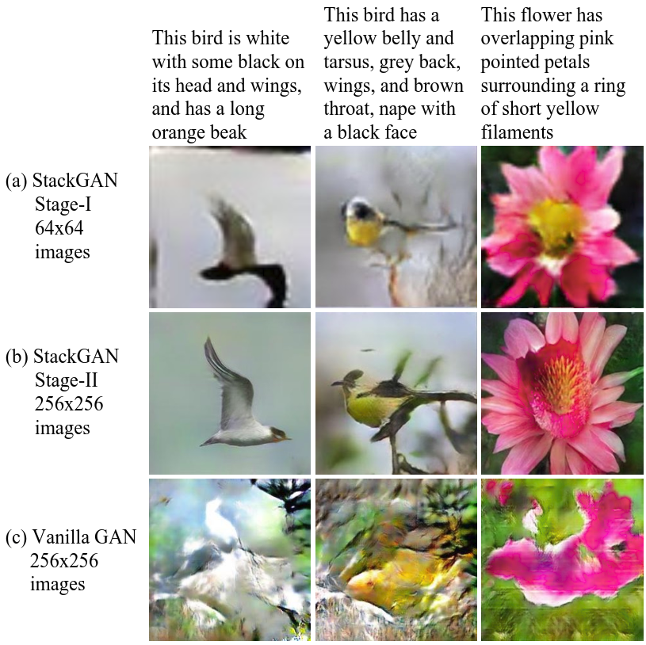
Text-to-Image Synthesis: State-of-the-Art
Stage I of StackGAN generates images comparable to other models
Stage II of StackGAN can upsample details like beaks and eyes of the birds in the CalTech-UCSD 200 Birds dataset
Trying to upsample to 256x256 with vanilla GAN architecture is unstable without the reconditioning with residual blocks
[3]

Slide 7
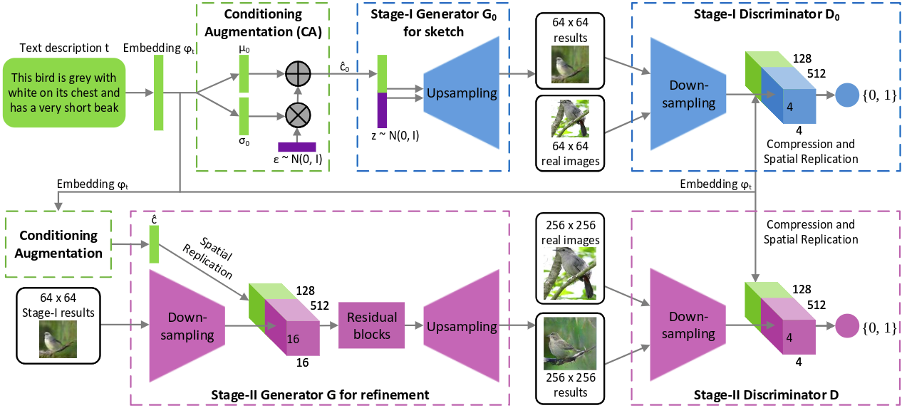
Text-to-Image Synthesis: State-of-the-Art
Full StackGAN architecture showing stage I and stage II GAN models
[3]

Slide 8
Materials
Labeled Faces in the Wild Dataset
13,233 images
Attributes text file containing numerical values for each of 72 facial features
Used a cropped version of LFW provided by Sanderson
Cropped images show only faces instead of background
Had to ensure consistency between LFWCrop and attributes file (left with 13,040 images)
Generated captions from numerical attributes file
Eliminated 18 attributes that have no relevance (hair, background, lighting)
Added an explicit “Female” attribute that is the negative of the “Male” attribute
Sorted attributes in non-increasing order and selected the largest 10 and 20 columns
Shuffled the word order of each caption to allow for latent manifold interpolation
Used a simplified StackGAN Tensorflow implementation with just stage I GAN
Difficult to train four neural networks with the time/resource constraints; two is much more feasible
Hyperparameter space of the full StackGAN model is squared w.r.t. the simplified version
[4] [5] [6]

Slide 9
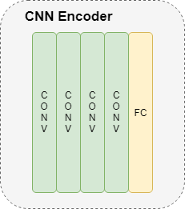
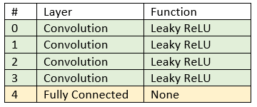
CNN to RNN Text Mapping
Notes:
Uses a CNN & RNN to map the images to text.

Slide 10
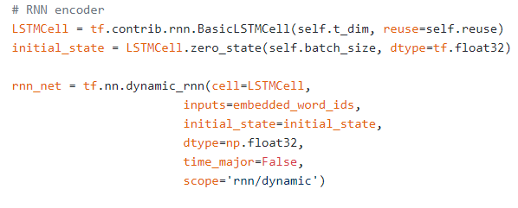
CNN to RNN Text Mapping
Notes:
Uses long short term memory and creates an RNN using tensorflow’s dynamic_rnn

Slide 11
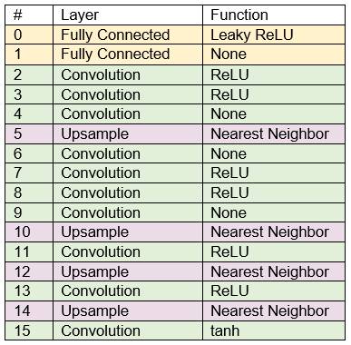
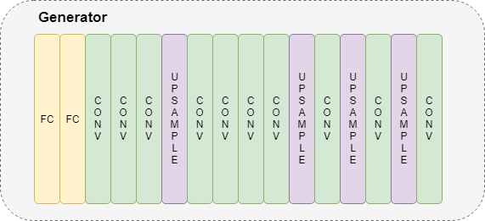
Generator Architecture

Slide 12
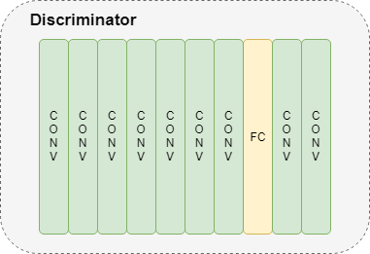
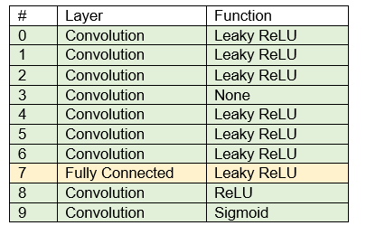
Discriminator Architecture

Slide 13
Training Machine Specs
CPU: 2.6 GHz Core i7-6700HQ
RAM: 16 GB
GPU: NVIDIA GTX 950M
640 Cuda Cores
914 + boost MHz clock
Maxwell Architecture

Slide 14
Methods
Only changed 1 parameter at a time on each run to see how it affected our outputs
Parameters that were changed:
Learning rate
Decay iteration
Decay changes the learning rate with the equation: learning rate ^ (epoch//decay rate)
Batch size
Sample sentences
Indian Gray Hair Big Nose Sunglasses Mustache Male
Asian Male Middle Aged Big Lips Pointy Nose Oval Face
White Pale Skin Wearing Lipstick Female Round Face Blond Hair
Sample sentence size

Slide 15
Methods
Run # | Iterations | Changes | Time Elapsed (hours)
1 | 175 | None | 14.58
2 | 200 | Decay at 50 epochs | 19.77
3 | 150 | Reduce description | 12.5
4 | 50 | Reduce labels in dataset | 4.61
5 | 107 | Batch size 144 from 64 | 8.4
6 | 125 | Batch size 144 Vocab & text embedding size change From 8000/256 to 53/10 | 10.5
7 | 79 | Batch size 144 & decay iteration at 25 | 6.35
Notes:
Total running time was 76.71 hours. No significant difference between runs except the following:
run 3 able to differentiate ethnicity a bit better.
Run 4 everyone had mustaches
Run 5 & 7 made everyone black
In hindsight, we should not have changed the decay iteration, but instead focused on speeding up learning at the beginning and decaying later on

Slide 16
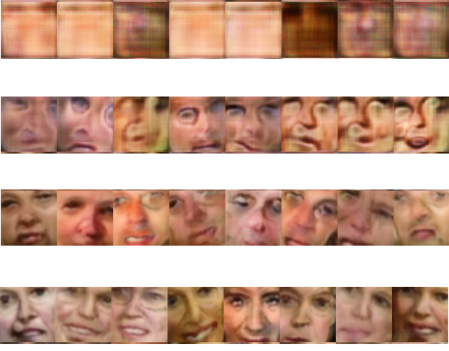
Results
Iteration
1st
5th
21st
34th

Slide 17
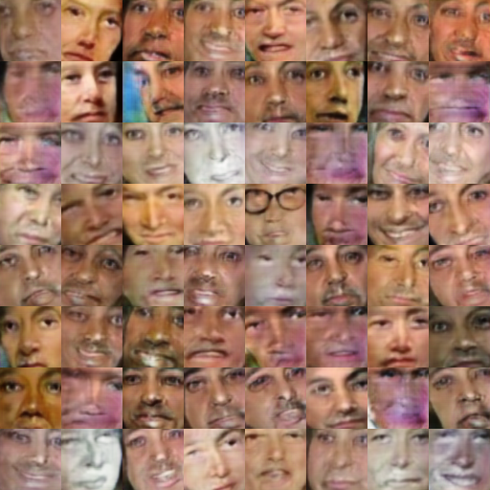
Results: Run 3
Asian Female Narrow Eyes Pointy Nose Oval Face Pale Skin Rosy Cheeks
Indian Gray Hair Big Nose Sunglasses Mustache Male
Black Female Middle Aged Big Lips Pointy Nose Square Face
Attractive Man 5 o' Clock Shadow Oval Face Brown Hair Eyeglasses
Youth Female Wearing Lipstick Mouth Slightly Open Fully Visible Forehead High Cheekbones Pointy Nose
White Pale Skin Wearing Lipstick Female Round Face Blond Hair
Brown Eyes Youth Male Oval Face No Beard No Eyewear White Sideburns Chubby
Female Indian Middle Aged Flushed Face Round Jaw Pointy Nose Arched Eyebrows High Cheekbones Oval Face
Notes:
Reduced number of descriptions

Slide 18
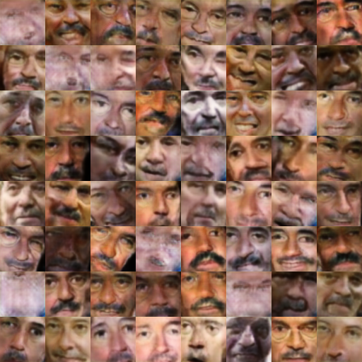
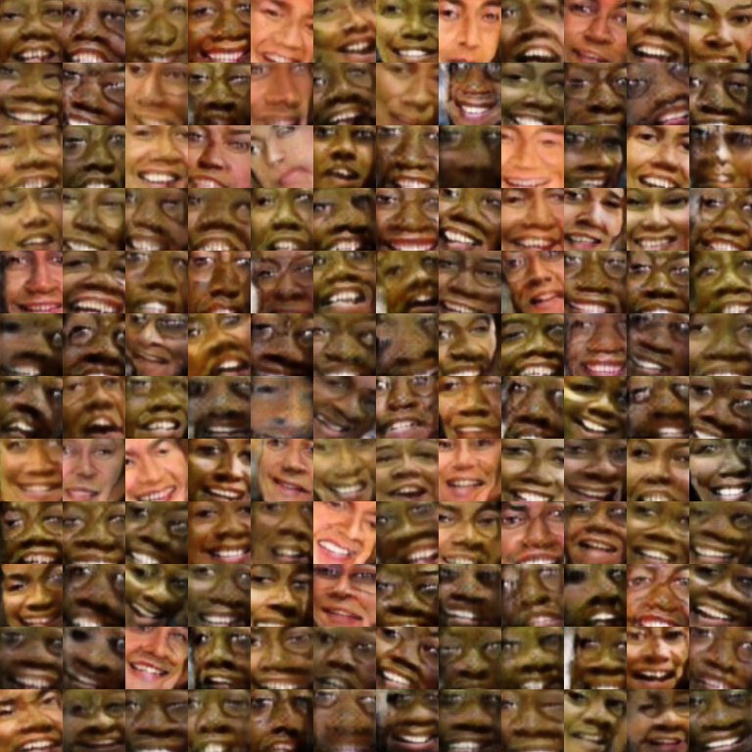
Results: Run 4 & 5
Notes:
Run 4: reduced label set
Run 5: reduced batch size

Slide 19
References
[1] I. Goodfellow, J. Pouget-Abadie, M. Mirza, B. Xu, D. Warde-Farley, S. Ozair, A. Courville, Y. Bengio, “Generative Adversarial Networks”, D’epartment d’informatique et de recherche operationnelle, University de Montreal, June 2014.
[2] M. Mirza, S. Osindero, “Conditional Generative Adversarial Nets”, D’epartment d’informatique et de recherche operationnelle, University de Montreal, November 2014.
[3] H. Zhang, T. Xu, H. Li, S. Zhang, X. Wang, X. Huang, D. Metaxas, “StackGan: Text to Photo-realistic Image Synthesis with Stacked Generative Adversarial Networks”, Rutgers University, Lehigh University, The Chinese University of Hong Kong, Baidu Research, August 2017.
[4] G. B. Huang, M. Ramesh, T. Berg, E. Learned-Miller, “Labeled Faces in the Wild: A Database for Studying Face Recognition in Unconstrained Environments”, University of Massachusetts, Technical Report 07-49, October 2007.
[5] C. Sanderson, B.C. Lovell, “Multi-Region Probabilistic Histograms for Robust and Scalable Identity Inference”, ICB 2009, LNCS 5558, pp. 199-208, 2009.
[6] H. Dong, “text-to-image”, published to GitHub at https://github.com/zsdonghao/text-to-image, 2018.

